Slide 1

Object Selection
_______________________
_______________________
Student:
Nguyen Van Khoi
Tran Hoang Nam
Supervisor:
MSc. Tu Trung Hieu

Slide 2
Introduction
Literature review
Problem statement
Interactive graph cut segmentation
Silent Lazy Snapping solution
Experimental results
Future direction
Question and answer

Slide 3
Image selection
An image is a set of sub-images that sometimes referred to as regions-of-interest, ROIs, or simply regions.
One of the problem in image processing is image selection – how to cut out or select an area for later specific image processing operations.

Slide 4
Interactive single-image segmentation
Interactive single-image segmentation (image cutout or foreground/background separation), one of the typical case in region selection problem, is to select the object (e.g. human, flower) from the background that based on samples provided by the user.

Slide 5
Introduction
Literature review
Problem statement
Interactive graph cut segmentation
Silent Lazy Snapping solution
Experimental results
Future direction
Question and answer

Slide 6
Graph cut for Interactive Segmentation

Slide 7
Lazy Snapping

Slide 8
Grabcut

Slide 9
Introduction
Literature review
Problem statement
Interactive graph cut segmentation
Silent Lazy Snapping solution
Experimental results
Future direction
Question and answer

Slide 10
Binary labelling problem

Slide 11
Min-cut Max-flow problem

Slide 12
Introduction
Literature review
Problem statement
Interactive graph cut segmentation
Silent Lazy Snapping solution
Experimental results
Future direction
Question and answer

Slide 13
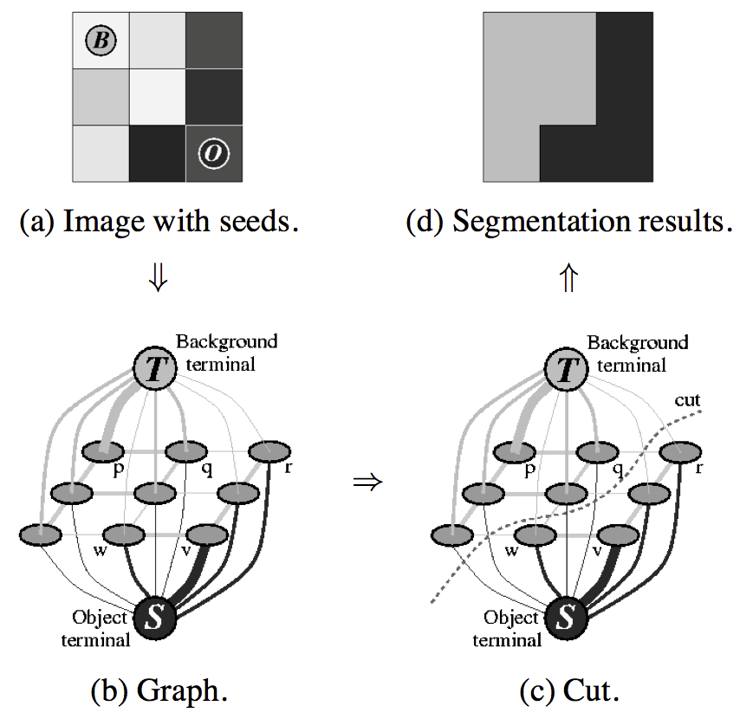
Graph cut construction
A simple segmentation example for a 3x3 image.

Slide 14
Energy function

Slide 15
Energy function (cont.)

Slide 16
Detailed implementation
Negative log-likelihood of intensity for regional term
Ad hoc function for boundary term
Max-flow algorithm provided by Boykov and Kolgomorov (2001)

Slide 17
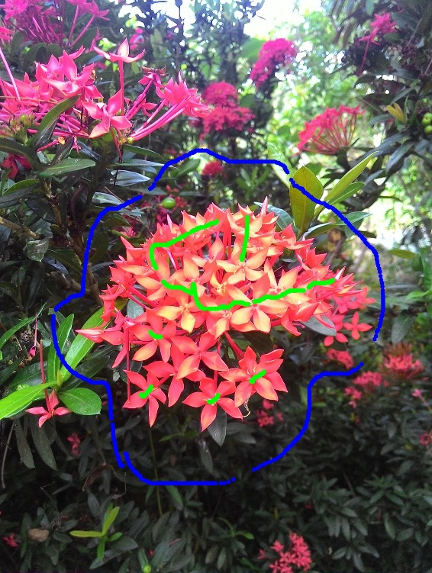

Sample result and comment

Slide 18
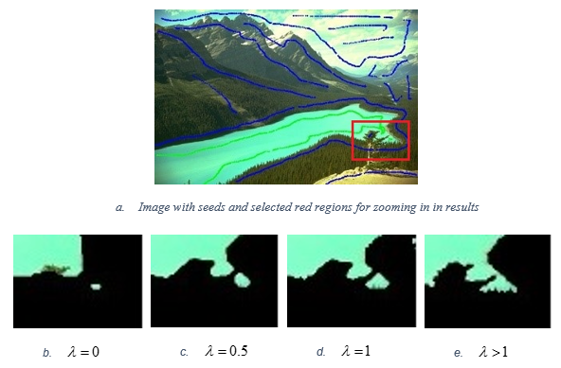
Sample result and comment (cont.)

Slide 19
Introduction
Literature review
Problem statement
Interactive graph cut segmentation
Silent Lazy Snapping solution
Experimental results
Future direction
Question and answer

Slide 20
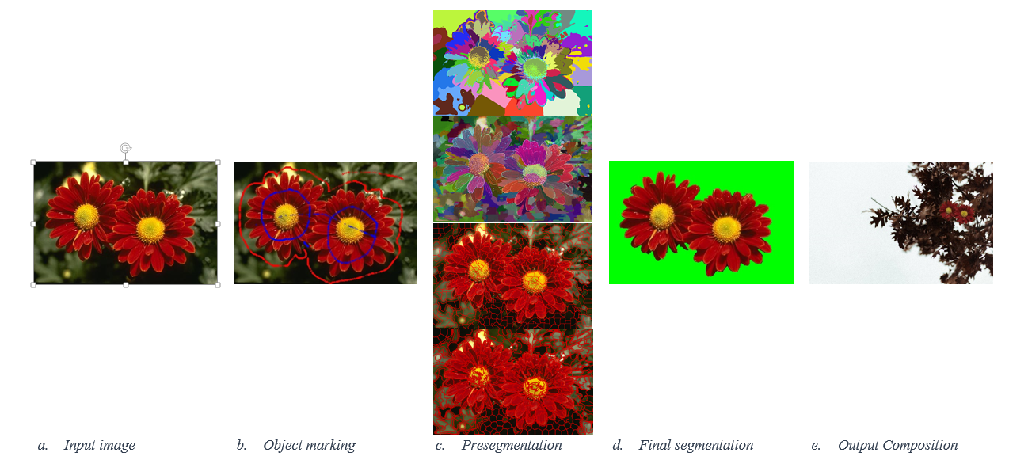
Silent Lazy Snapping model

Slide 21
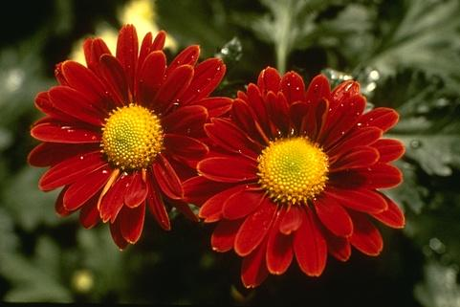
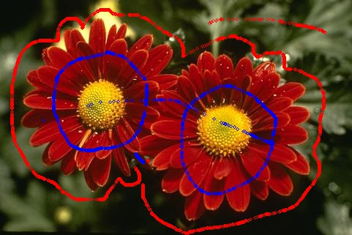
Step 1: Sample definition

Slide 22
Sample definition step
User action:
Visualize examples by drawing strokes/points in input image.

Slide 23
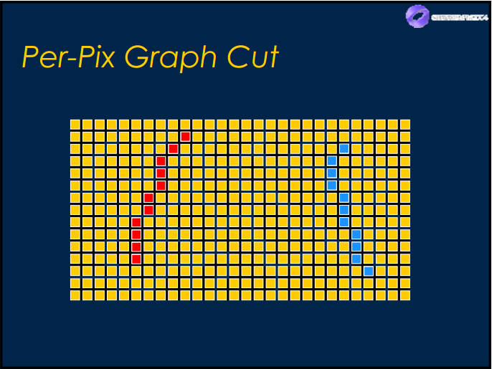
Sample definition step
Sample definition in pixel level:
Blue color: pixel belongs to foreground/object.
Red color: pixel belongs to background.

Slide 24

Step 2: Pre-segmentation by SEEDs algorithm

Slide 25
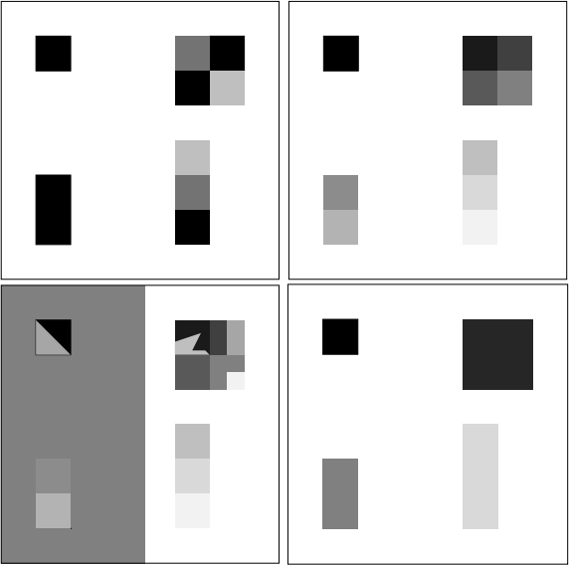
Over-segmentation: pixels belong to same object are classified as belonging to different segments. A single object may be represented by two or more segments.

Slide 26
Under-segmentation: pixels belong to different objects are classified as belonging to the same object. A single segment may contain several objects.

Slide 27

Pre-segmentation step K-means method (4124 segments)
Cannot control the number of segments.
Over-segmentation problem.
Easy to implement, but require time and memory.

Slide 28
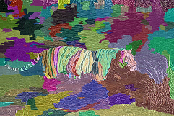
Pre-segmentation step Watershed method (212 segments)
Cannot control the number of segments.
Under-segmentation problem.
Unstable because result depends on threshold value.

Slide 29
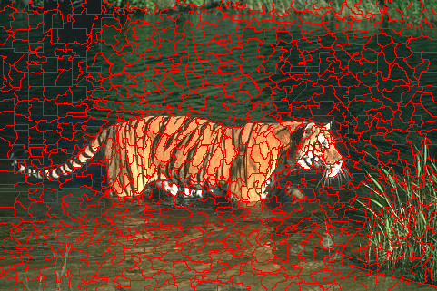
Pre-segmentation step SEEDs – Super pixel (800 segments)
Can control the number of segments.
Depend on the number of iteration.
Under-fitting boundary problem.

Slide 30
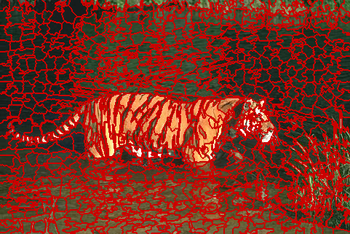
Pre-segmentation step SEEDs – Revised Mean Pixel (800 segments)
Can control the number of segments.
Depend on the number of iteration.
Stable, usable result.

Slide 31
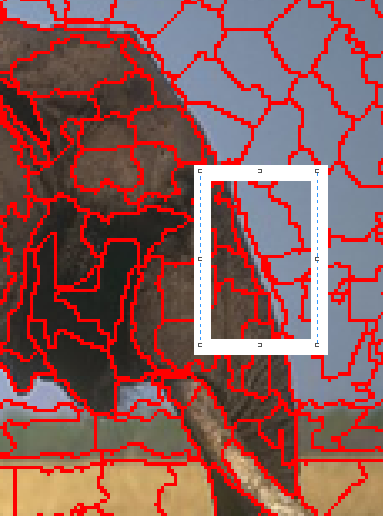
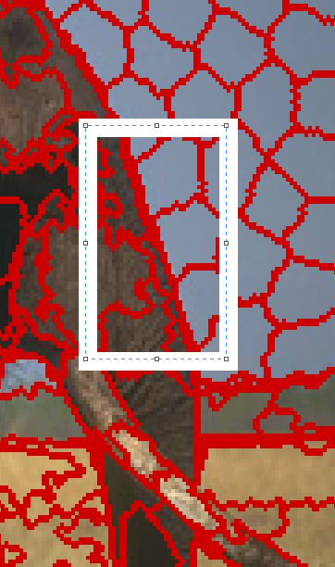
Comparison between SEEDs Super Pixel and SEEDs Revised Mean Pixel
SEEDs Super Pixel
SEEDs Revised Mean Pixel

Slide 32
Why SEEDs Revised Mean Pixels?
Can control the number of segments.
Can control the number of iteration.
Avoid over/under segmentation problem.
Avoid under-fitting boundary problem.
Linear complexity: O(5*N) (N – number of pixel in the original image)

Slide 33
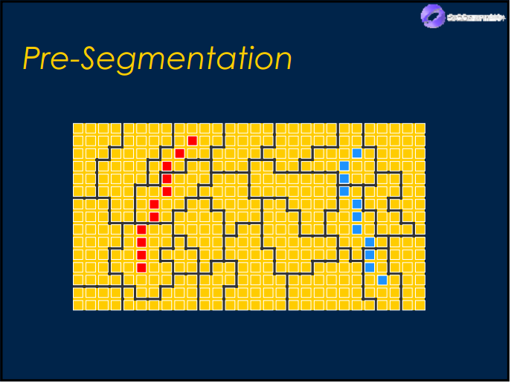
Pre-segmentation step
Segments combine with sample definition in pixel level:
Blue color: pixel belongs to foreground/object.
Red color: pixel belongs to background.

Slide 34
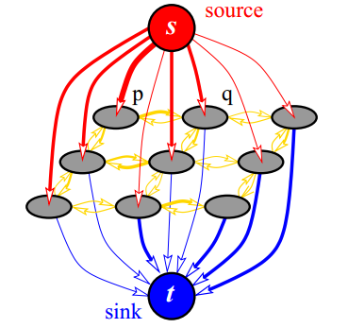
Step 3: Graph initialization

Slide 35
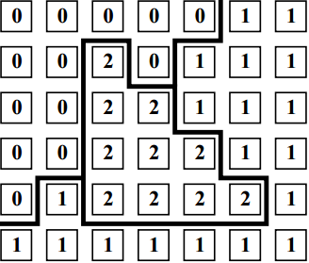
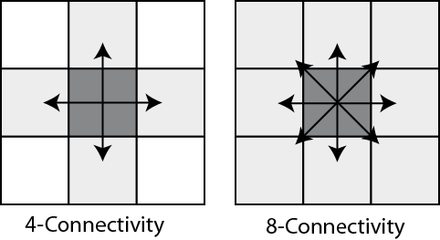
Network properties
Network G = (V, E)
V = {source, sink, segments}
|V| = number of segments + 2
I(u) = mean value of segment u
E = {t-link, n-link}
If pixel p with label L[p] is a neighbor of pixel q with label L[q] and L[p] <> L[q], so p and q are neighbor in the network.
If pixel p belongs to foreground sample, we mark vertex L[p] connect to source.
If pixel q belongs to background sample, we mark vertex L[q] connect to sink.

Slide 36
T-link cost
Use K-means method to cluster the color of foreground seeds and background seeds .
The mean colors of each set are denote as and .
Each node has its color .

Slide 37
N-link cost
is the L2-Norm of RGB color difference between two pixels p and q.
More detailed, we use Euclidean distance to compute .

Slide 38
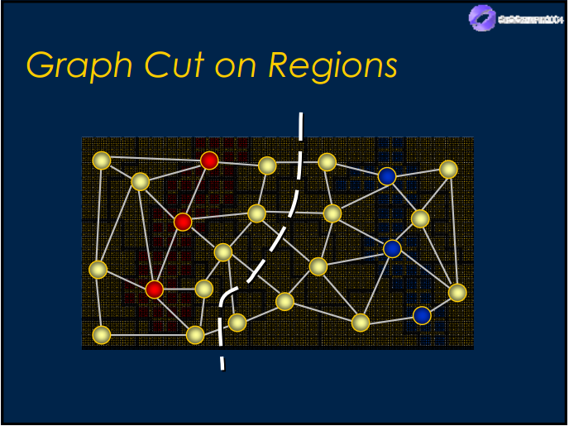
Step 4: Graph cut and final segmentation

Slide 39
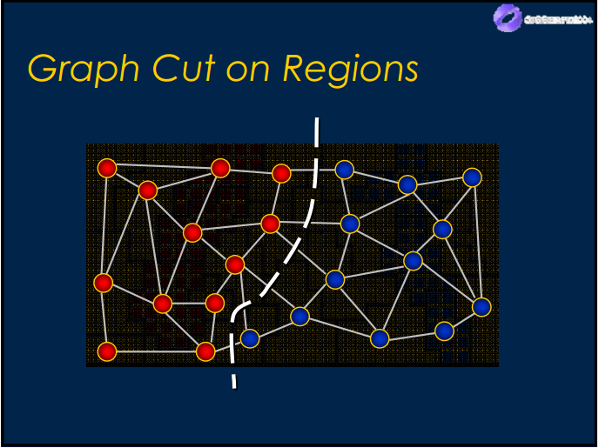
Final segmentation
We apply Graph Cut solution of Yuri Boykov and Vladimir Kolmogorov to the network to solve maximum flow problem.

Slide 40
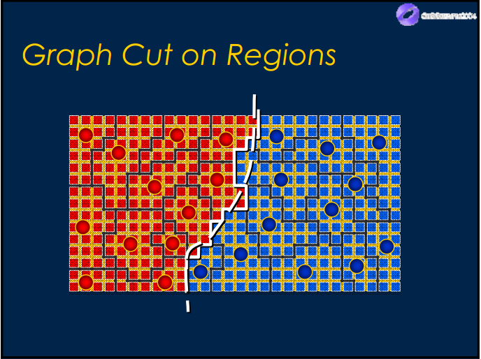
Final segmentation
We transfer label value of vertices back to all regions in the original image, change color or background regions to get final segmentation – object selection.

Slide 41

Sample result

Slide 42
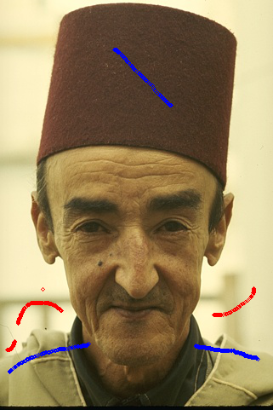

Limitation 1: Pixel loss in thin area
189080 with samples
Final segmentation

Slide 43
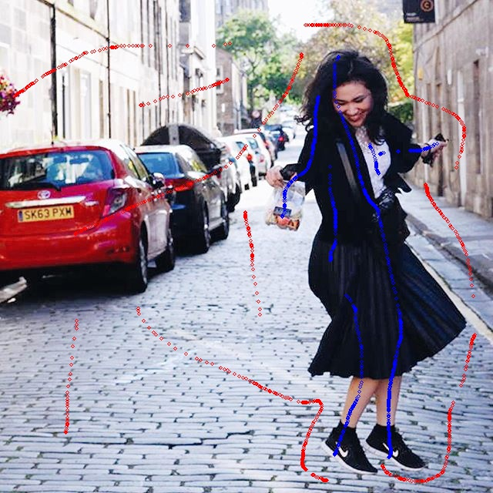

Limitation 2: Unsmooth boundary
Dancing_Emily with samples
Final segmentation

Slide 44
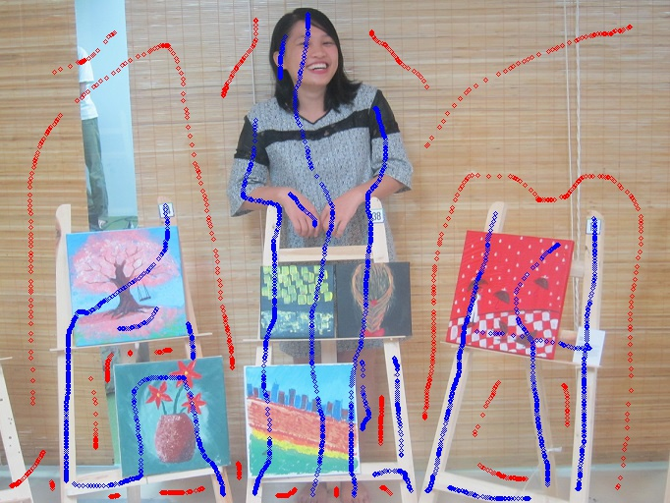
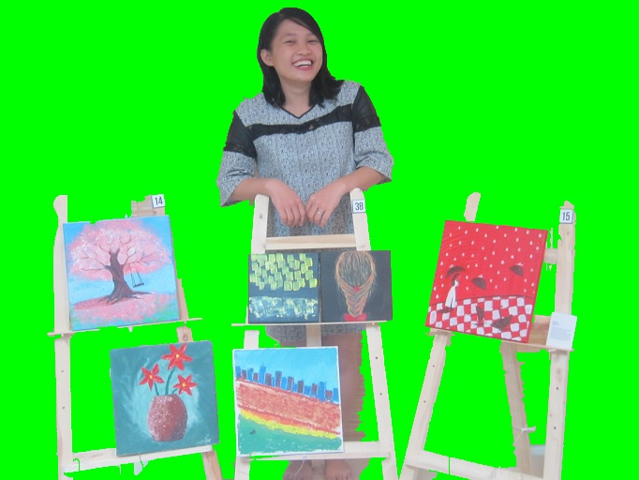
Limitation 3: Poor performance when foreground and background have similar color distribution
Vango with samples
Final segmentation

Slide 45
Introduction
Literature review
Problem statement
Interactive graph cut segmentation
Silent Lazy Snapping solution
Experimental results
Future direction
Question and answer

Slide 46
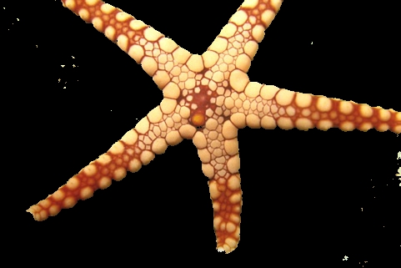
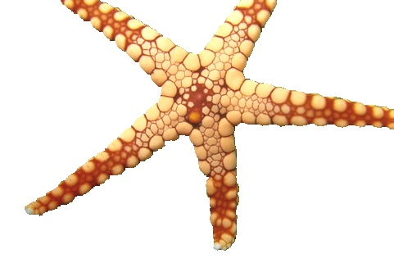
Berkeley dataset – 12003.jpg
Interactive Graph Cut
Silent Lazy Snapping

Slide 47

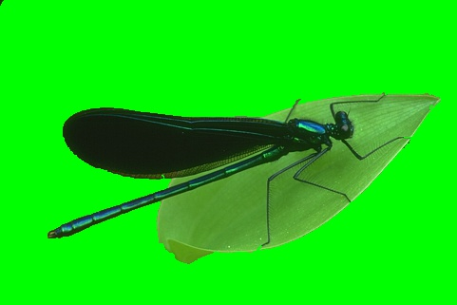
Berkeley dataset – 35070.jpg
Interactive Graph Cut
Silent Lazy Snapping

Slide 48


Berkeley dataset – 176035.jpg
Interactive Graph Cut
Silent Lazy Snapping

Slide 49


Berkeley dataset – 187029.jpg
Interactive Graph Cut
Silent Lazy Snapping

Slide 50
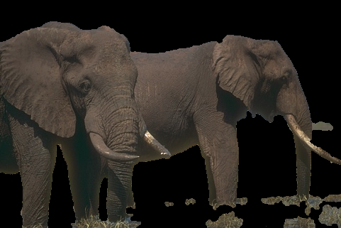
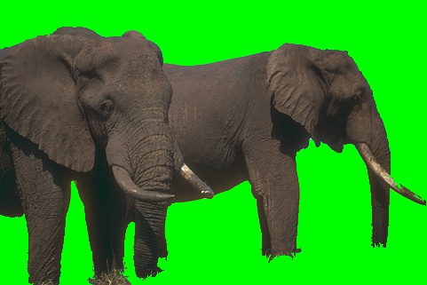
Berkeley dataset – 207056.jpg
Interactive Graph Cut
Silent Lazy Snapping

Slide 51
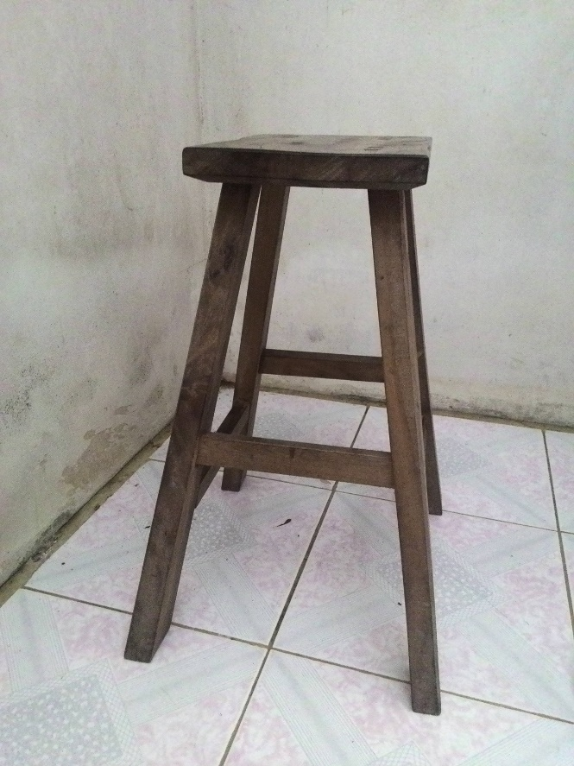
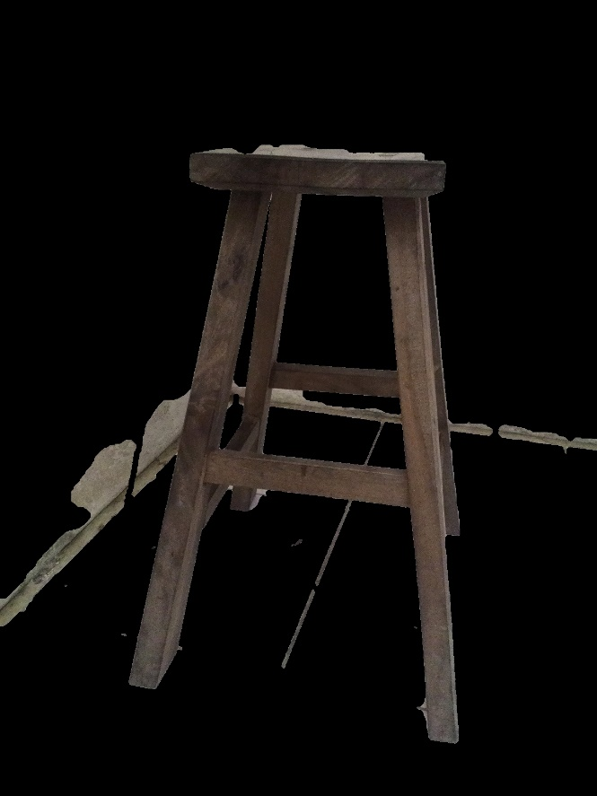
Khoi’s dataset – 5.jpg
Original Image
Interactive Graph Cut

Slide 52
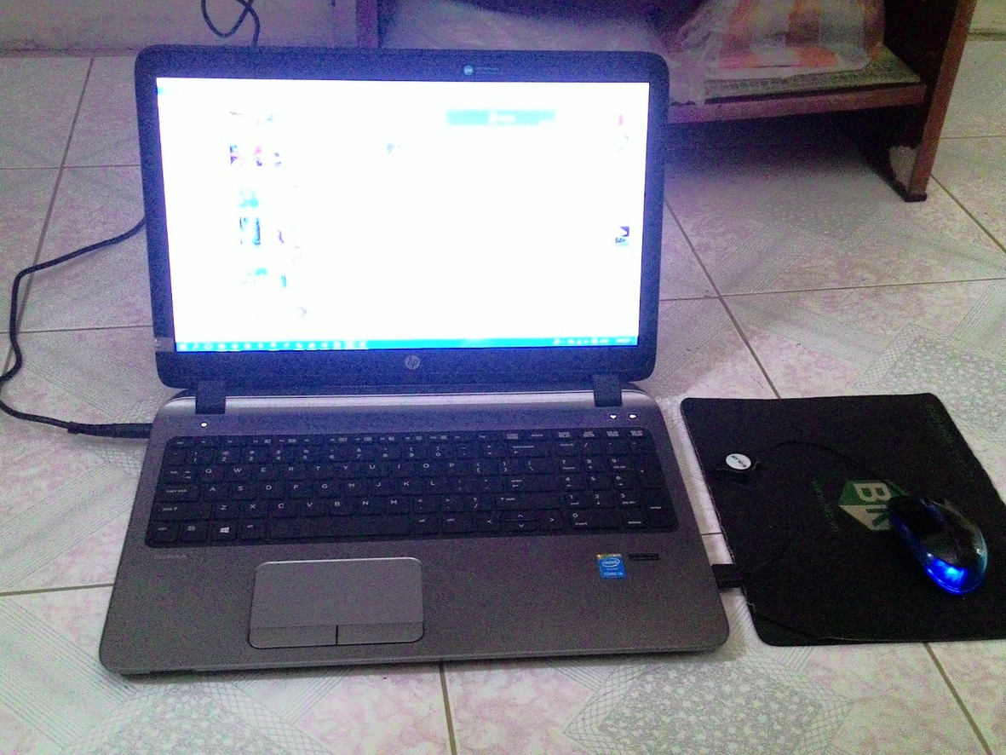
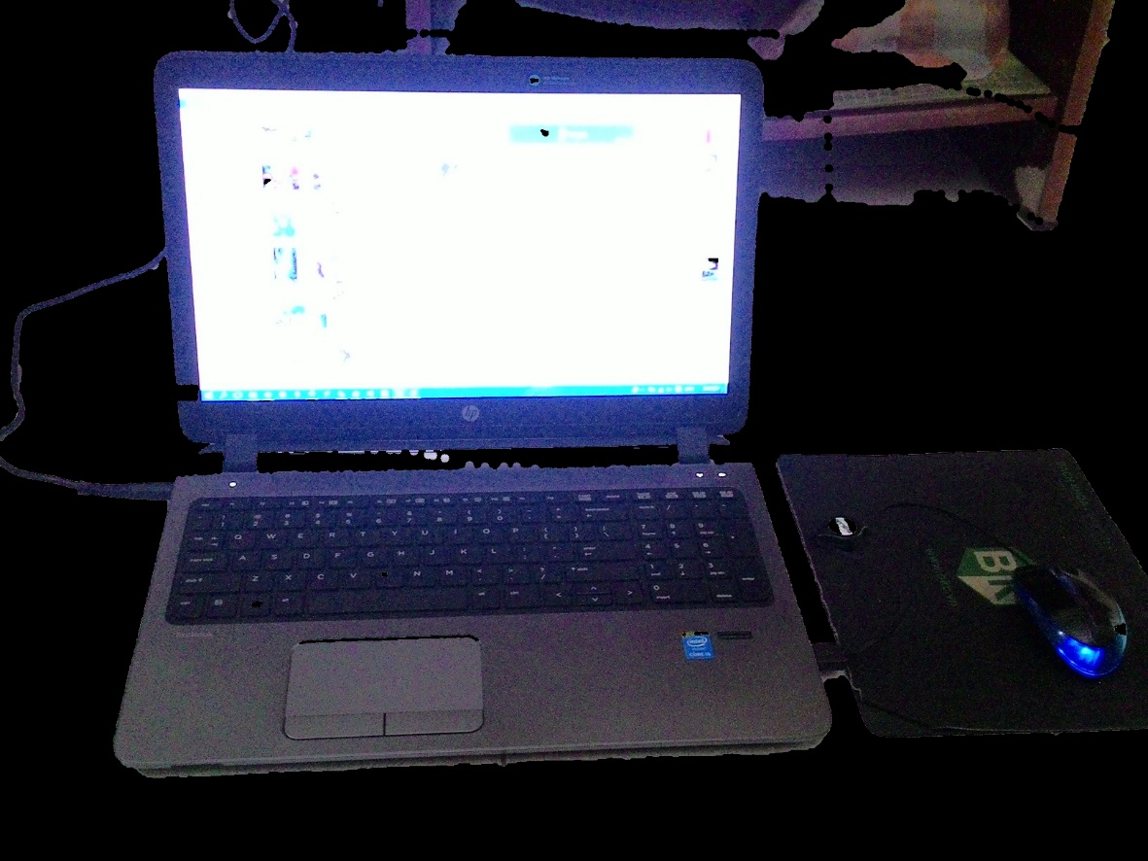
Khoi’s dataset – 6.jpg
Original Image
Interactive Graph Cut

Slide 53
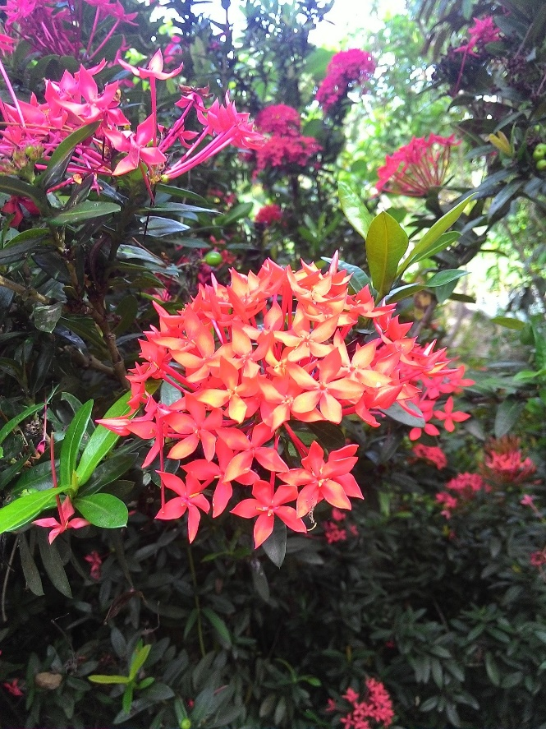

Khoi’s dataset – 7.jpg
Original Image
Interactive Graph Cut

Slide 54
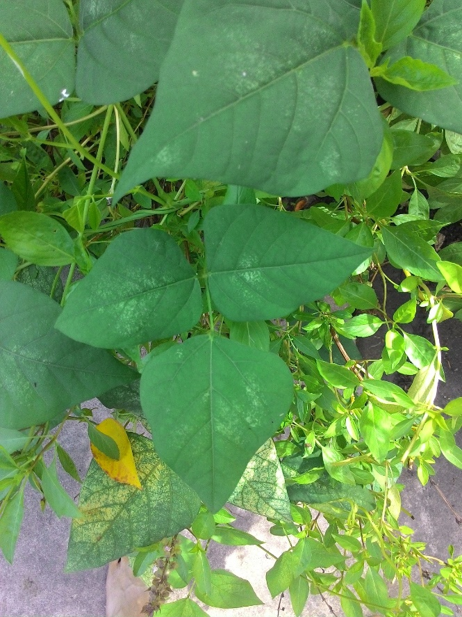

Khoi’s dataset – 8.jpg
Original Image
Interactive Graph Cut

Slide 55
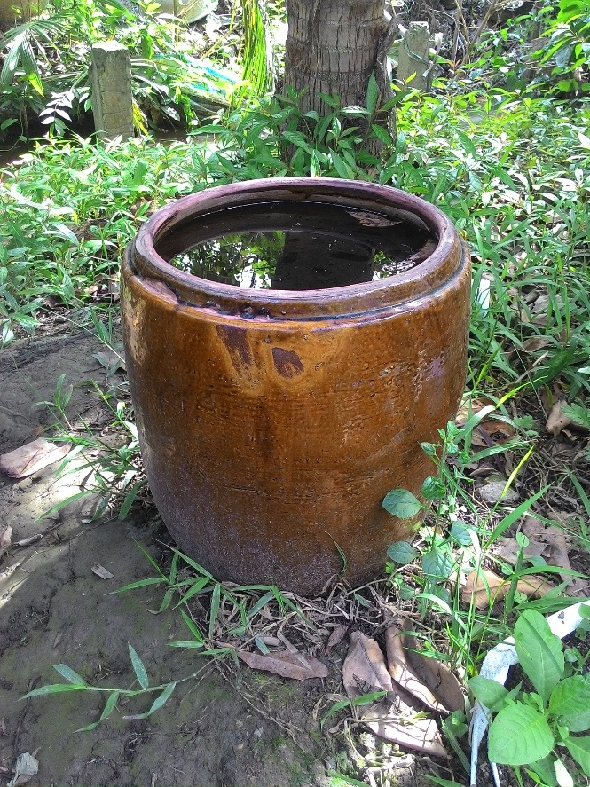
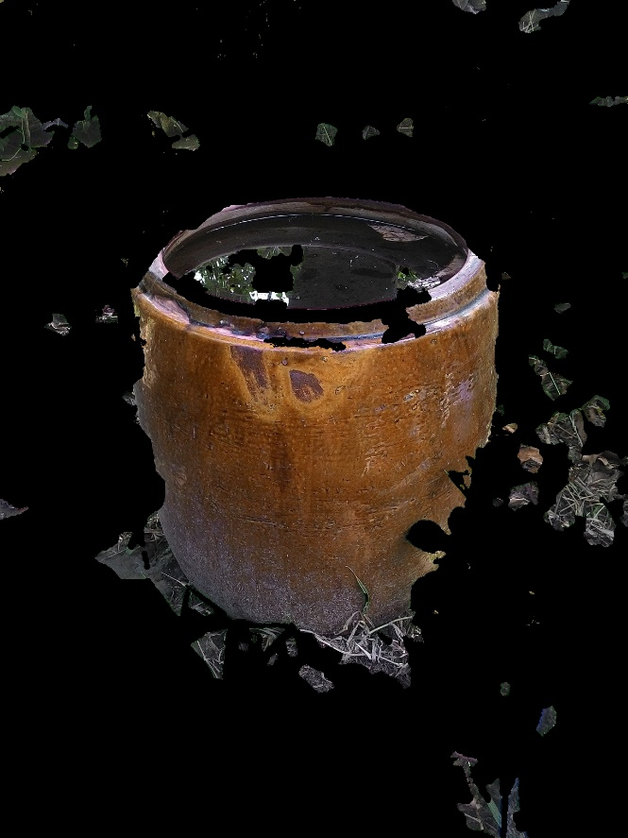
Khoi’s dataset – 9.jpg
Original Image
Interactive Graph Cut

Slide 56


Nam’s dataset – Cat.jpg
Original Image
Silent Lazy Snapping

Slide 57


Nam’s dataset – TrangAn.jpg
Original Image
Silent Lazy Snapping

Slide 58

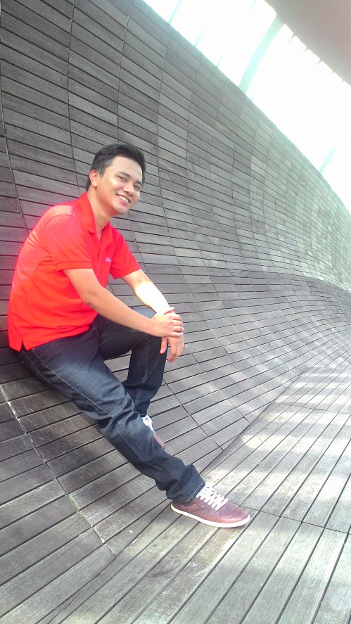
Nam’s dataset – Nam_2.jpg
Original Image
Silent Lazy Snapping

Slide 59

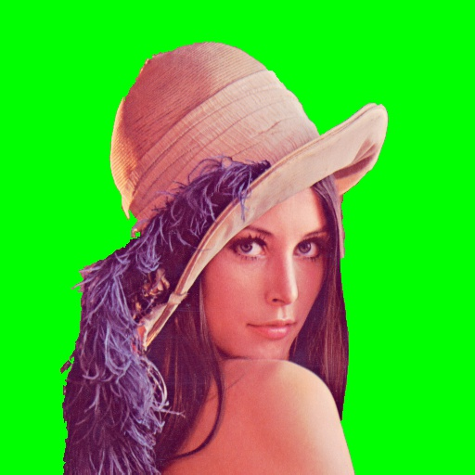
Nam’s dataset – WSpaper.jpg
Original Image
Silent Lazy Snapping

Slide 60


Nam’s dataset – Emily_child.jpg
Original Image
Silent Lazy Snapping

Slide 61
Introduction
Literature review
Problem statement
Interactive graph cut segmentation
Silent Lazy Snapping solution
Experimental results
Future direction
Question and answer

Slide 62
Introduction
Literature review
Problem statement
Interactive graph cut segmentation
Silent Lazy Snapping solution
Experimental results
Future direction
Question and answer

